Slide 1

Azure data factory File and pipeline metadata
SCOTT PETERS
https://advancedsqlpuzzles.com

Slide 2
objective
The contents of this demo can be found in the following GitHub repository:
https://github.com/smpetersgithub/AdvancedSQLPuzzles/tree/main/Microsoft%20Azure/Data%20Factory%20Metadata%20Demo

Slide 3
objective
In this presentation we will create several pipelines to import text files into a SQL Server database and append all metadata from both the text files and the pipeline.
This demo will cover the following topics:
File and Pipeline Metadata
Parameters and Variables
User-Defined Table Types
First, we will start with Metadata.

Slide 4
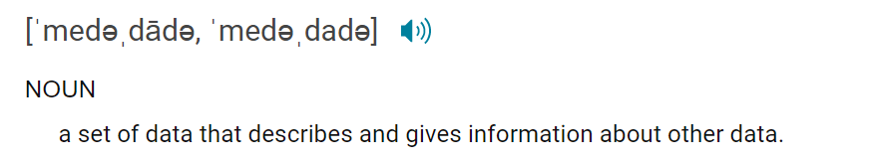
metadata
What is metadata?

Slide 5
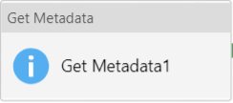
metadata
Azure Data Factory provides the Get Metadata activity to retrieve metadata from a dataset.
“You can use the Get Metadata activity to retrieve the metadata of any data in Azure Data Factory or a Synapse pipeline. You can use the output from the Get Metadata activity in conditional
expressions to perform validation, or consume the metadata in subsequent activities.“
https://docs.microsoft.com/en-us/azure/data-factory/control-flow-get-metadata-activity

Slide 6
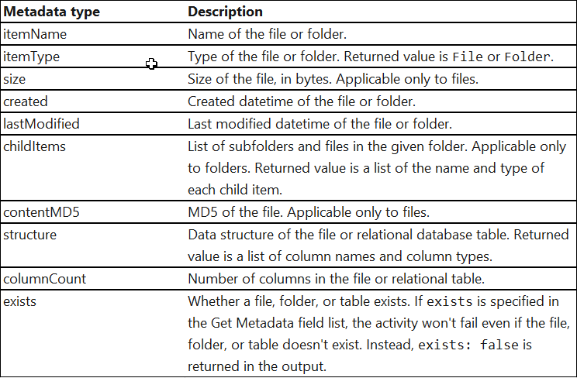
metadata
Using a dataset, we can specify the following metadata types in the Get Metadata activity field list.
Some of the metadata types are specific to folders, and some are specific to files.
I’ve noted the type size is listed in the documentation but does not appear in the Get Metadata drop down, which we will see later.

Slide 7
Parameters vs variables
Next, we will cover parameters and variables.

Slide 8
Parameters vs variables
Parameters
A parameter is a named variable passed into a function by the callee.
The value of a parameter cannot be changed inside the function.
The values passed to a parameter are called arguments.
Variables
A variable is a memory location.
The value of a variable can change during program execution.
Variables are used to store information to be referenced and manipulated in a computer program.

Slide 9
Parameters vs variables
You can use parameters to pass external values into:
Pipelines
Datasets
Linked Services
Data Flows
Once the parameter has been passed into the resource, it cannot be changed. By parameterizing resources, you can reuse them with different values each time.

Slide 10
Parameters vs variables
Data Factory has two types of variables:
System Variables that capture pipeline metadata.
User Variables to store values which are referenced by the pipeline.
User variables can be set via the Set variable or the Append variable activity. There are three data types of user-defined variables available:
String
Boolean
Array

Slide 11
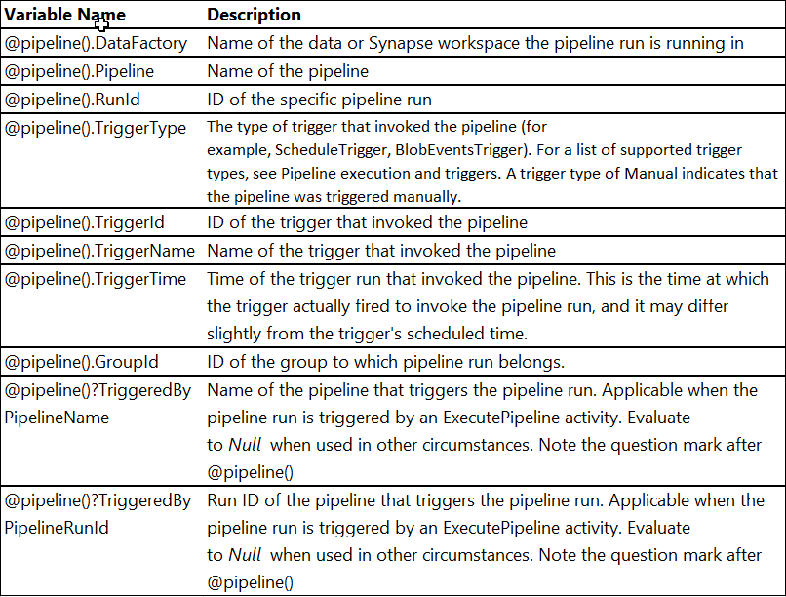
Parameters vs variables
System variables capture pipeline metadata and can be referenced anywhere in the pipeline.
https://docs.microsoft.com/en-us/azure/data-factory/control-flow-get-metadata-activity

Slide 12
Data factory
Next, we will briefly cover linked services and datasets.

Slide 13
Data factory
What are datasets and linked services?
“A dataset is a named view of data that simply points or references the data you want to use in your activities as inputs and outputs. Datasets identify data within different data stores, such as tables, files, folders, and documents. For example, an Azure Blob dataset specifies the blob container and folder in Blob storage from which the activity should read the data.
Before you create a dataset, you must create a linked service to link your data store to the service. Linked services are much like connection strings, which define the connection information needed for the service to connect to external resources.”
https://docs.microsoft.com/en-us/azure/data-factory/concepts-datasets-linked-services

Slide 14



Data factory
Azure Data Factory
Trigger
Trigger
General framework of an
Azure Data Factory.
The joining of triggers, pipelines, activates, datasets and linked services is a many to many relationship.
Pipeline
Activity
Activity
Dataset
Dataset
Dataset
Linked Service
Linked Service
Linked Service

Slide 15

Pipeline 1
Before we begin creating a pipeline to insert metadata into a SQL Server table.
We will first create a pipeline with a Copy data activity that inserts data from a text file into a SQL Server table without any extra metadata.
The setup to insert metadata into a SQL Server table is a bit tricky. We will start with a simple pipeline and then build from here.

Slide 16
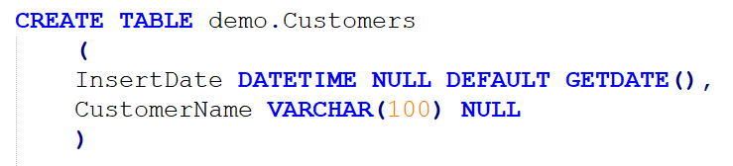
Pipeline 1
We will insert the data from a set of customer files
into the following SQL Server table.

Slide 17
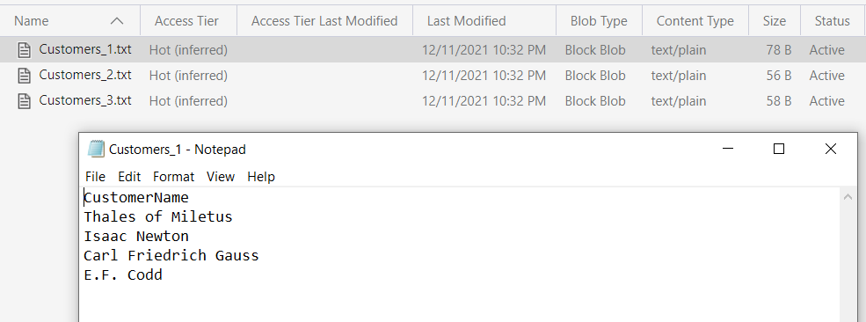
Pipeline 1
I created 3 text files and inserted the names of famous mathematicians into the files. We will be inserting these files into the Customers table we created.

Slide 18
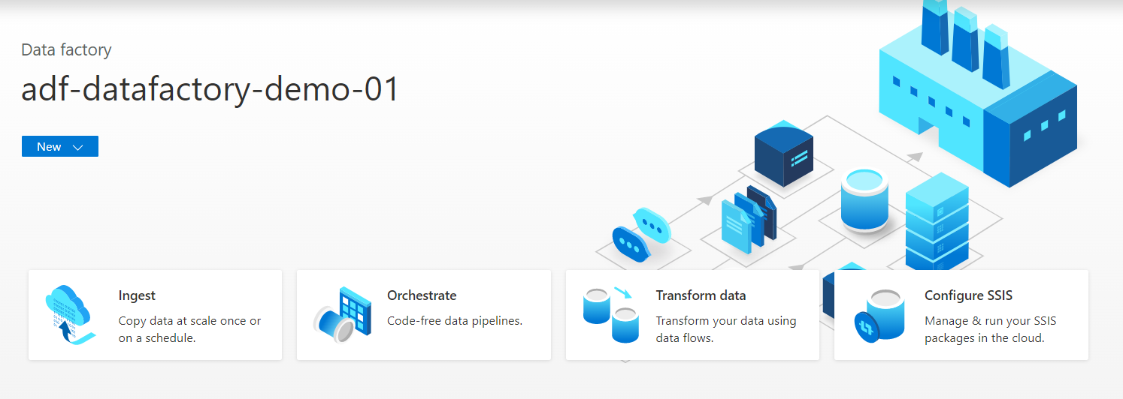
Pipeline 1
The fastest method to create a pipeline is to select the Ingest option from the home screen. This method will auto-create the activities, linked services and datasets via a wizard.

Slide 19
Pipeline 1
We will need to create the following two datasets for our pipeline.
Name | Data Store | Type
source_directory | Azure Blob Storage | Format type is DelimitedText
Customers_table | Azure SQL Database | References the table Customers

Slide 20
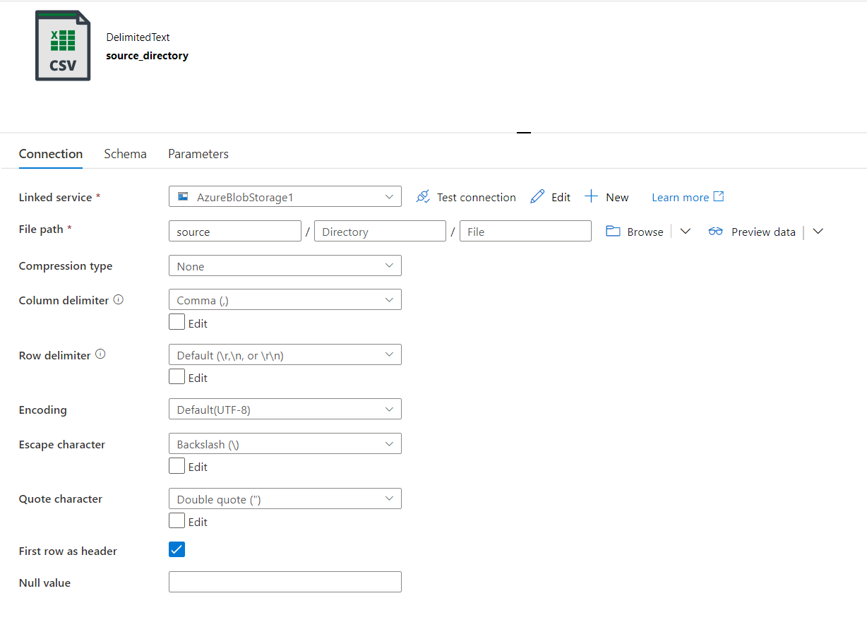
Pipeline 1
Create the dataset source_directory that points to the Azure Storage Account directory where you stored the customer text files.
Leave the filename blank.

Slide 21
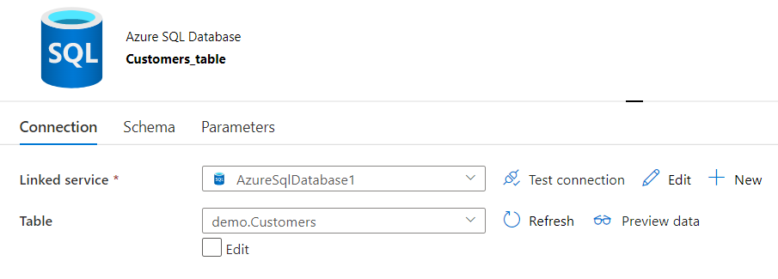
Pipeline 1
Create the Customers_table dataset referencing the table Customers.

Slide 22
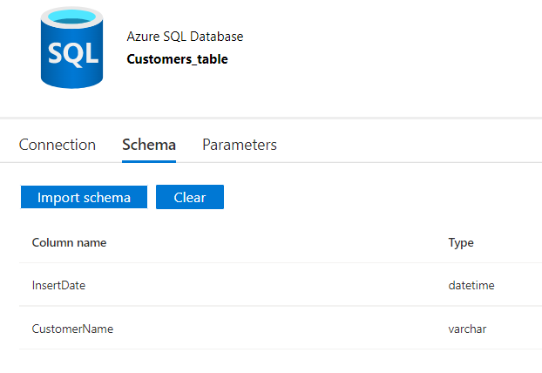
Pipeline 1
In the Schema tab, import the schemas for your datasets.
The schema in the datasets may be unneeded, but consider it best practice to set these and ensure they are correct.

Slide 23
Pipeline 1
Next, we will setup the Data Factory pipelines.

Slide 24
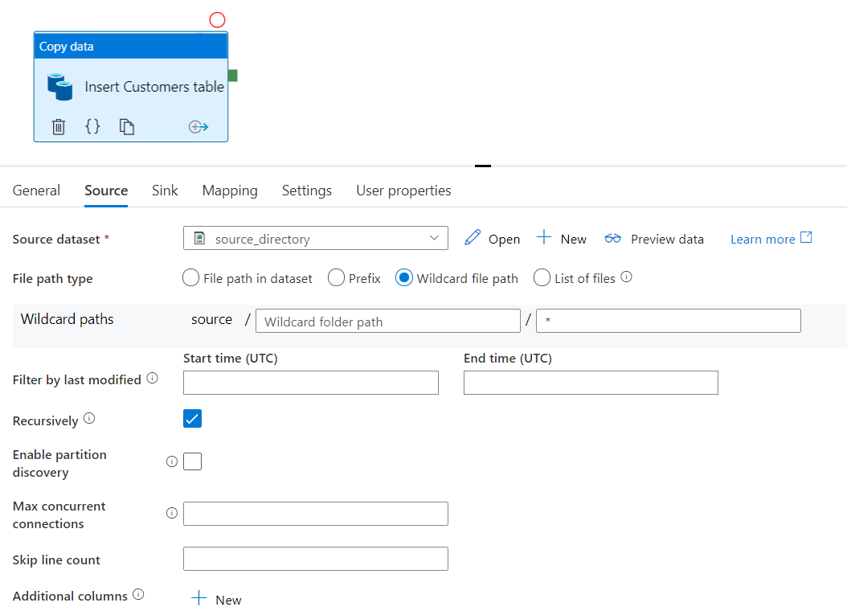
Pipeline 1
Insert a Copy data activity into the workflow.
In the Source tab, select the Source dataset and select Wildcard folder path as the File path type.

Slide 25
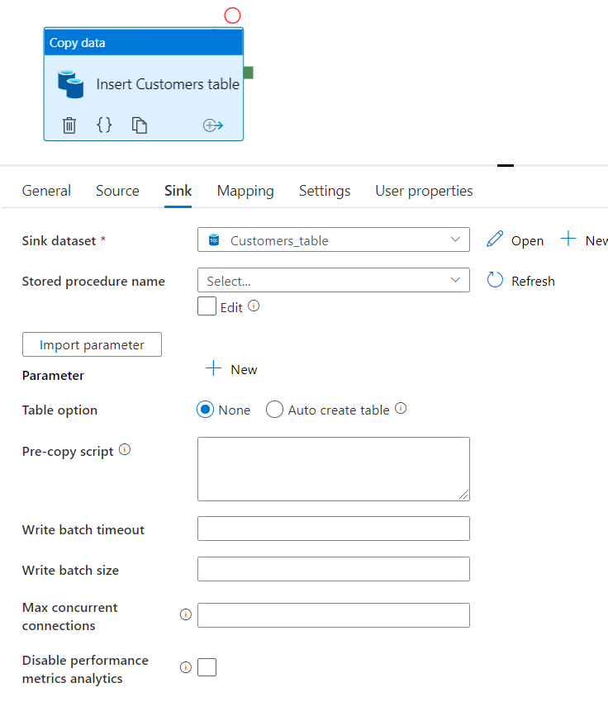
Pipeline 1
The Sink tab will have the following setup.
For now, all that is required for this tab is to set the Sink dataset input.
Leave the Stored procedure name dropdown blank, we will use this in subsequent examples.

Slide 26
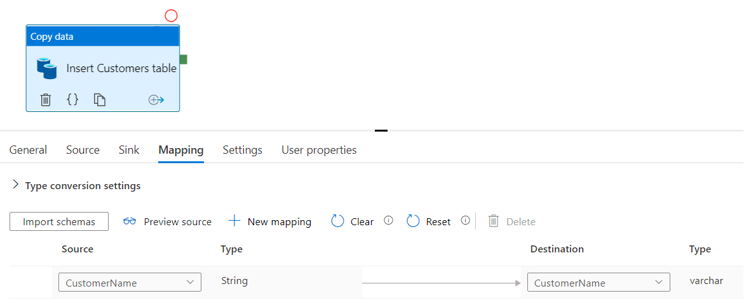
Pipeline 1
In the Mapping tab, set the Source and Destination drop downs to the appropriate columns as shown.

Slide 27
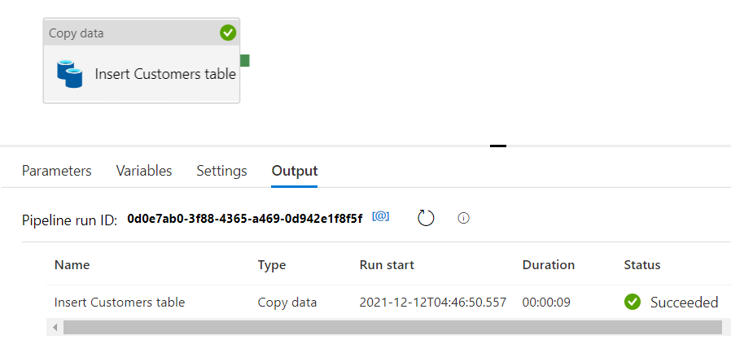
Pipeline 1
Execute the pipeline and check the data has been inserted into the Customers table.

Slide 28
Pipeline 2
Next, we are going to insert the UTC date using dynamic content from the pipeline into the InsertDate of the Customers table.

Slide 29
Pipeline 2
For this pipeline, we will need to create two SQL Server objects:
User-Defined Table Type
Stored Procedure
A user-defined table type is a user-defined type that represents the definition of a table structure. We can use user-defined table type to declare table-valued parameters for stored procedures or functions.
The stored procedure will reference the user-defined table type.

Slide 30

Pipeline 2
Create the following user-defined table type. This UDT matches the schema of the customer text files.

Slide 31
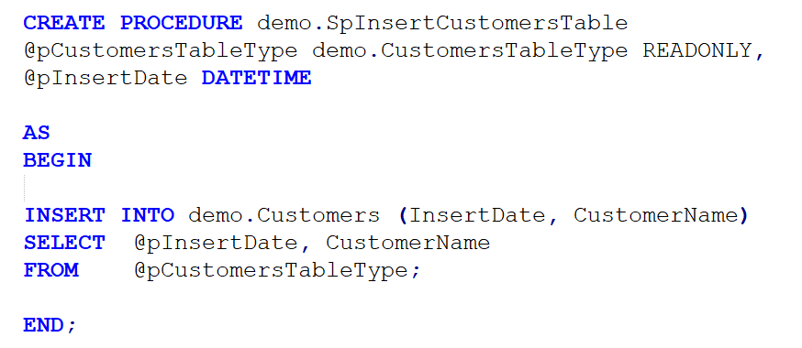
Pipeline 2
Then create a stored procedure that uses the user-defined table type as a parameter.
We will use these objects in our pipeline.

Slide 32
Pipeline 2
No changes need to be done to our current datasets.
Next, we will add the Copy data activity in our new pipeline.

Slide 33
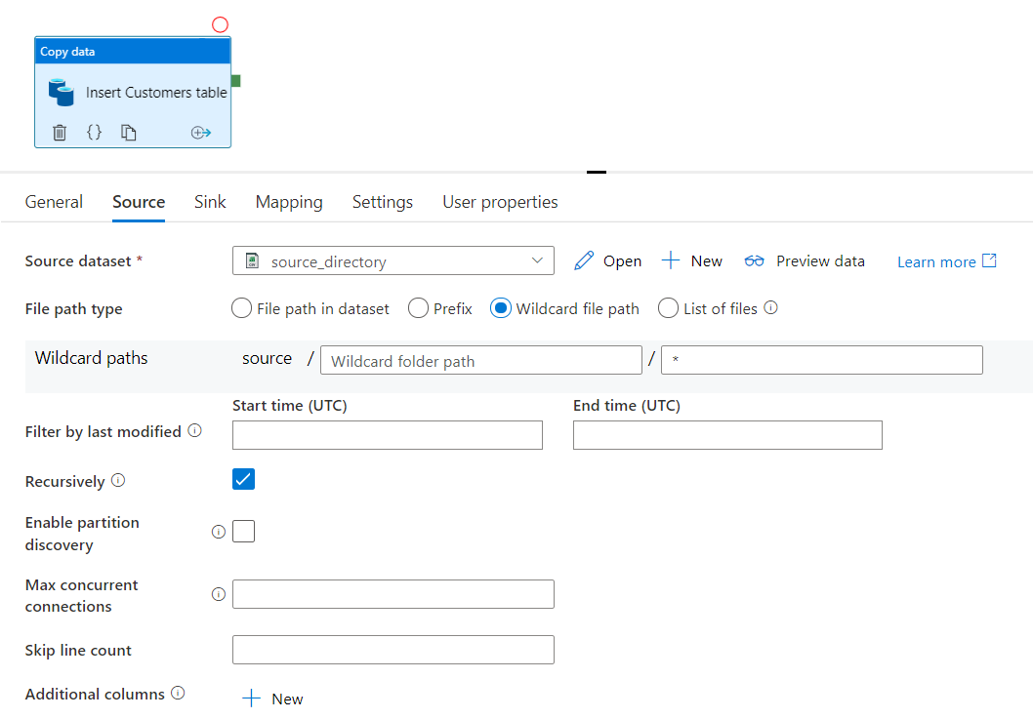
Pipeline 2
Insert a Copy data activity and set the Source tab properties as shown.
These are the same properties we used in the previous pipeline’s Copy data activity.

Slide 34
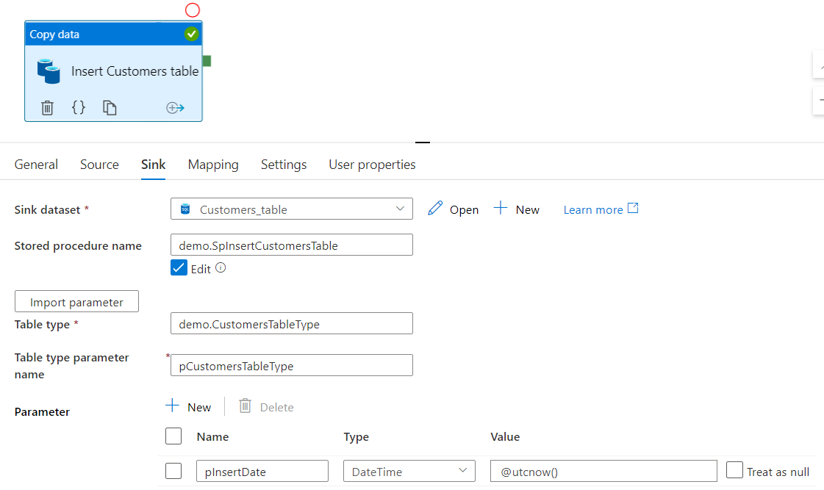
Pipeline 2
Next, set the Sink tab properties as shown.
Ensure table type uses a two-part naming convention!
Set this to the stored procedure
Value is @utcnow()

Slide 35
Pipeline 2
We are now passing the coordinated universal time to the parameter pInsertDate.
The schema of the table Customers matches the UDT we selected in the Table type input box.

Slide 36
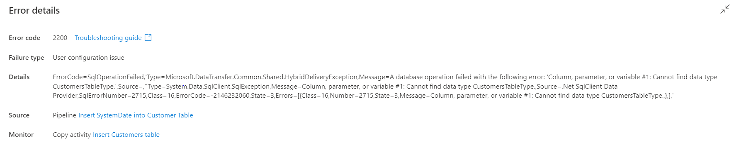
Pipeline 2
If you do not use the two-part naming convention in the Table type input box, you will get the following error.
Make sure you specify the schema name in the Table type input box!

Slide 37
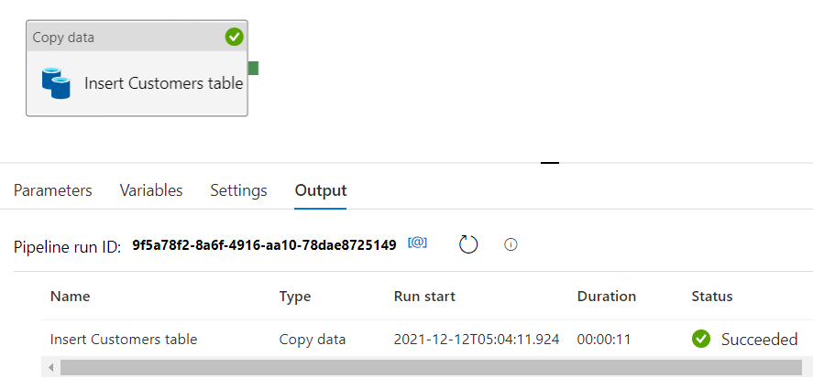
Pipeline 2
Run the pipeline and ensure the data was inserted into the Customers table.

Slide 38
Pipeline 3
Next, we will create a pipeline inserting the metadata from both the file and the pipeline.

Slide 39
Pipeline 3
We will need to create the following objects with the new fields we want to populate.
A new Customers table
A new Stored Procedure
We can use the existing user-defined table type that we created, as this matches the schema of the customers files.
The DDL scripts are available in the Git repository located at:
https://github.com/smpetersgithub/AdvancedSQLPuzzles/tree/main/Microsoft%20Azure/Data%20Factory%20Metadata%20Demo

Slide 40
Pipeline 3
We will also need to add the following:
Additional activities to loop through each file and read the file’s metadata.
An additional dataset that parameterizes the filename.

Slide 41
Pipeline 3
We will need to create a new dataset named source_parameter that has a parameterized file name, and a new dataset named CustomersMetadata_table that references our new table.
Name | Data Store | Type
source_directory | Azure Blob Storage | Format type is DelimitedText
CustomersMetadata_table | Azure SQL Database | References the table CustomersMetadata
source_parameter | Azure Blob Storage | Format type is DelimitedText

Slide 42
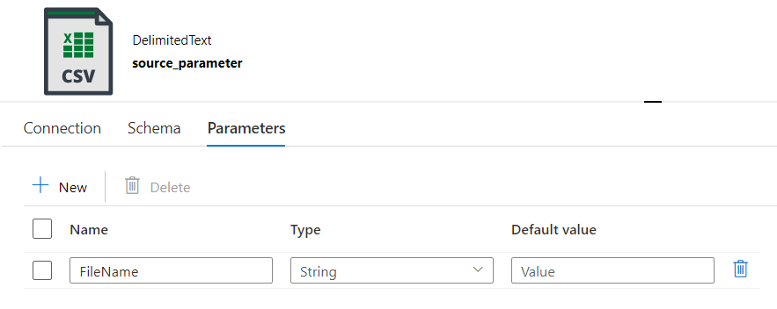
Pipeline 3
For the new dataset that references the Azure Storage Account source directory, create a parameter named FileName.

Slide 43
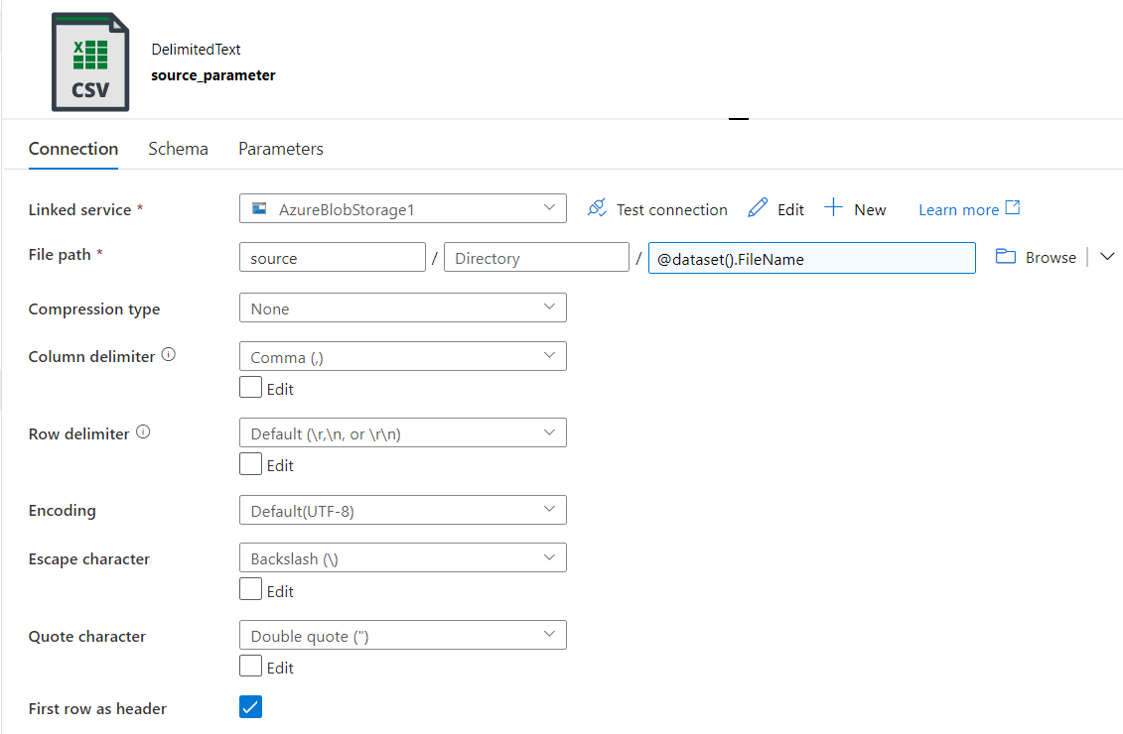
Pipeline 3
Then reference the parameter in the connection tab of the new dataset. Add the argument using the dynamic content window. Also, ensure you have properly set First row as header.

Slide 44
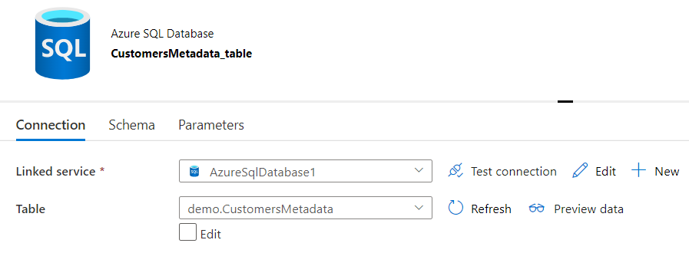
Pipeline 3
Create the CustomersMetadata_table dataset referencing the table CustomersMetadata.

Slide 45
Pipeline 3
Next, we will build the following activities in the pipeline.
1 | Get Metadata | Returns a list of file in the source directory
2 | ForEach | Creates a loop
3 | Get Metadata | Determine metadata for a single file
4 | Copy data | Insert data into Customers table

Slide 46
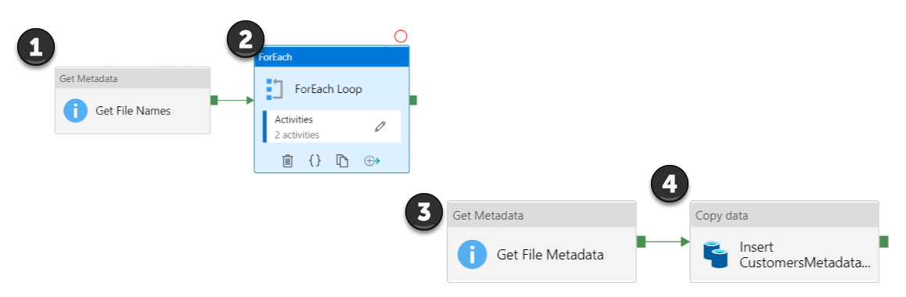
Pipeline 3
The activities in the pipeline will look like the following.
We will step through each of these activities in the following slides.

Slide 47
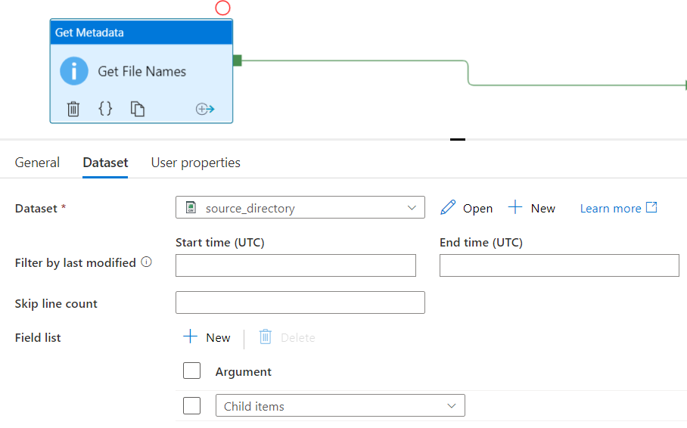
Pipeline 3
First, insert a Get Metadata activity into the pipeline and insert a new argument into the Field list and then select Child items.
This will return a list of files in the source directory.

Slide 48
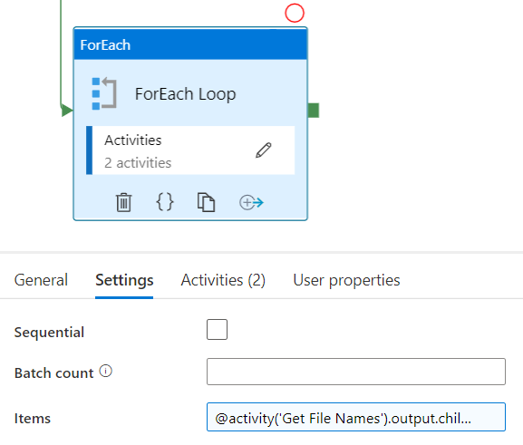
Pipeline 3
Next, insert a ForEach activity into the pipeline and set the Items input box as show.
Next, we will insert two activities into the ForEach loop.
@activity('Get File Names').output.childItems

Slide 49
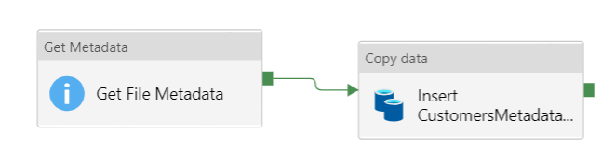
Pipeline 3
Insert a Get Metadata and a Copy data activity within the ForEach activity.

Slide 50
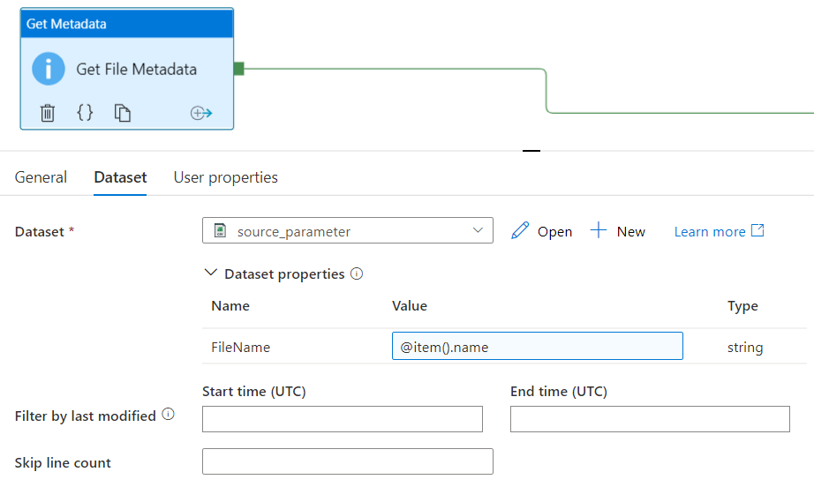
Pipeline 3
The Get Metadata activity within the ForEach activity will use the new source_parameter dataset that we created.
There are several settings that we need to input that we will go over in the next slides.

Slide 51
Pipeline 3
Set the dataset to the new source_parameter dataset we created
The FileName parameter argument will be @item().name

Slide 52
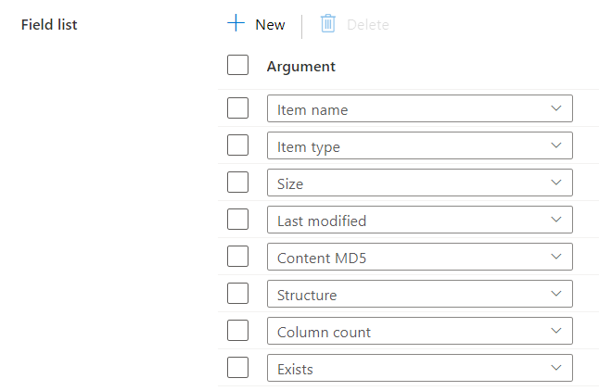
Pipeline 3
Scroll down in the Get Metadata activity and select all the available fields available as shown. Note here there is no created argument, as described in the Microsoft documentation.

Slide 53
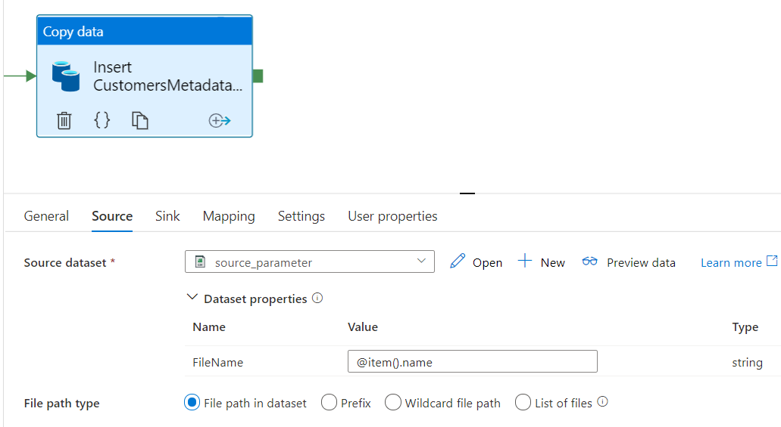
Pipeline 3
The Copy data activity has the following options in the Source tab. Use the source_parameter dataset and insert the FileName value as shown.

Slide 54
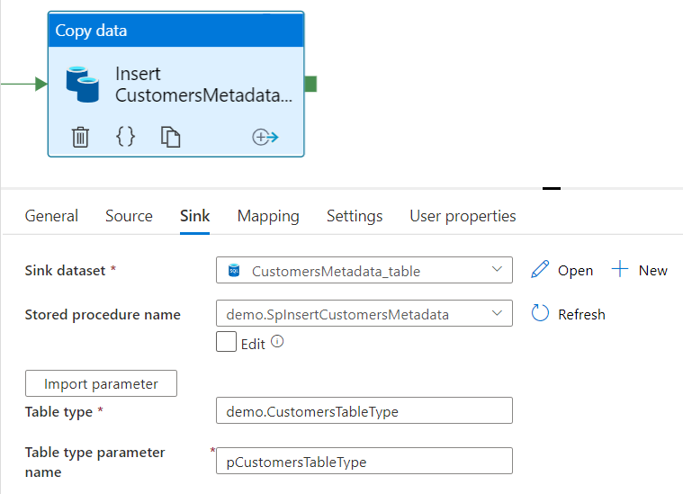
Pipeline 3
Set the Sink dataset to the CustomersMetadata table we created. Insert the Stored procedure name and select Import parameter.
Ensure your table type has a two-part naming convention! It does not default to the two-part name.

Slide 55
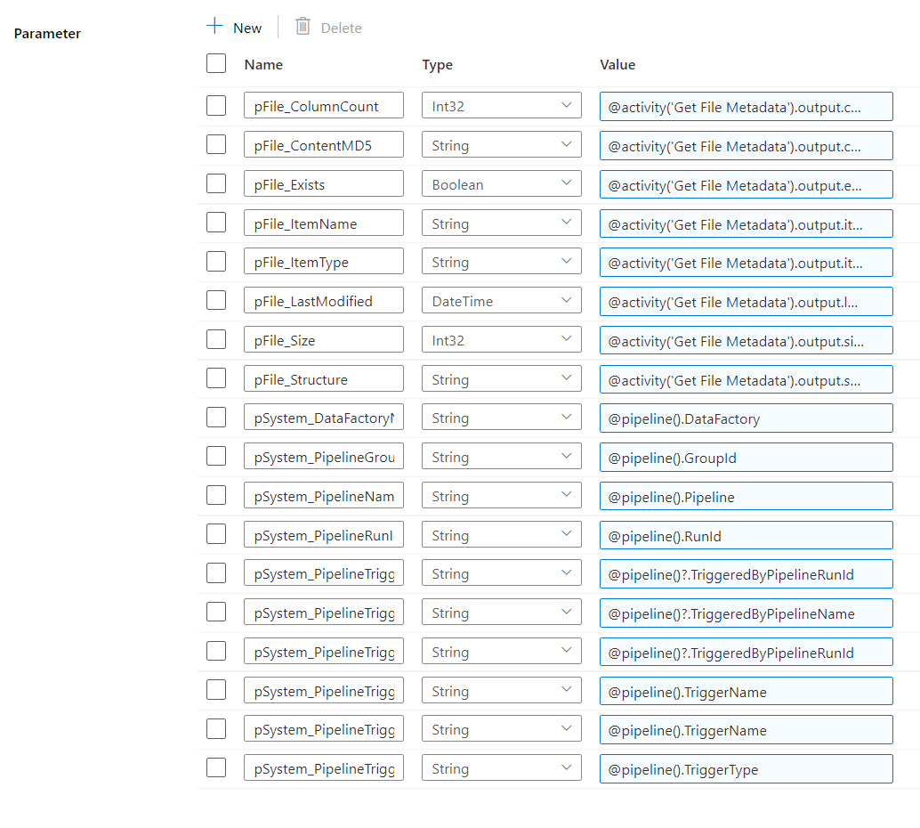
Pipeline 3
In the Sink tab of the Copy data activity, we will need to perform the same operations as we did in pipeline 2, but this time we insert the metadata values for the parameters.

Slide 56
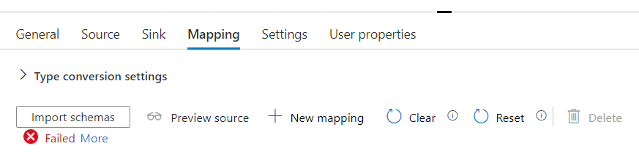
Pipeline 3
In the Mapping tab, the red Failed error is perfectly fine here.

Slide 57
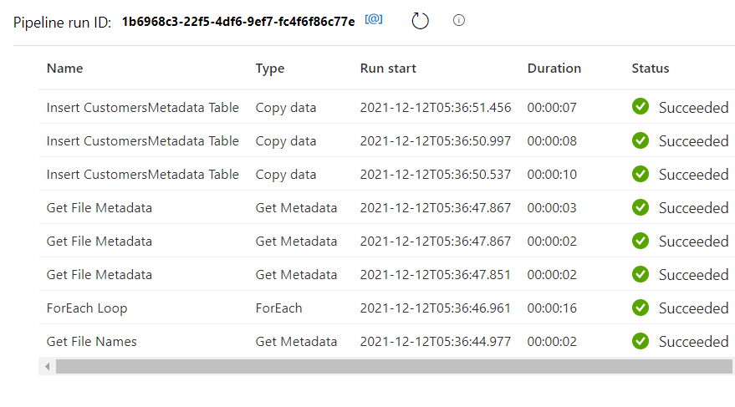
Pipeline 3
Execute the pipeline and check the data has been inserted into the CustomersMetadata table.

Slide 58

Column | Value
InsertDate | 12/5/2021 18:18
CustomerName | Alan Turing
File_ItemName | Customers_1.txt
File_ItemType | File
File_Size | 48
File_LastModified | 12/2/2021 0:48
File_ContentMD5 | n05np0tEsV8zCIBKcC4wHg==
File_Structure | System.Collections.Generic.List`1[System.Object]
File_ColumnCount | 1
File_Exists | 1
System_DataFactoryName | adf-datafactory-demo-01
System_PipelineName | Insert_Customers_Metadata
System_PipelineRunId | 87fae8e9-492b-40b1-b9d0-d581989fa605
System_PipelineTriggerType | ScheduleTrigger
System_PipelineTriggerId | NULL
System_PipelineTriggerName | ExampleTrigger
System_PipelineTriggerTime | ExampleTrigger
System_PipelineGroupID | 87fae8e9-492b-40b1-b9d0-d581989fa605
System_PipelineTriggeredByPipelineName | NULL
System_PipelineTriggerByPipelineRundId | NULL
Example metadata from a scheduled trigger execution.

Slide 59
Column | Value
InsertDate | 12/3/2021 17:31
CustomerName | Thales of Miletus
File_ItemName | Customers_1.txt
File_ItemType | File
File_Size | 70
File_LastModified | 12/3/2021 12:34
File_ContentMD5 | YXwu44TeGEE14g03inSDwg==
File_Structure | System.Collections.Generic.List`1[System.Object]
File_ColumnCount | 1
File_Exists | 1
System_DataFactoryName | adf-datafactory-demo-01
System_PipelineName | Insert_Customers_Metadata
System_PipelineRunId | afde1fbf-32d8-47e0-b453-2d4340cc346a
System_PipelineTriggerType | Manual
System_PipelineTriggerId | NULL
System_PipelineTriggerName | Sandbox
System_PipelineTriggerTime | Sandbox
System_PipelineGroupID | afde1fbf-32d8-47e0-b453-2d4340cc346a
System_PipelineTriggeredByPipelineName | NULL
System_PipelineTriggerByPipelineRundId | NULL
Example metadata from a debug execution.

Slide 60
ADDITIONAL
Additionally, we can copy the customer files to a destination directory and append a date to the filename.
Create a parameterized dataset like the source_parameter dataset we created. Then use dynamic content to populate the filename.
See the following Microsoft documentation:
https://docs.microsoft.com/en-us/azure/data-factory/control-flow-expression-language-functions

Slide 61
ADDITIONAL
If you want to populate a table with only the metadata and not the data in the text files, change the Copy data activity to a Stored procedure activity.
See the following Microsoft documentation:
https://docs.microsoft.com/en-us/azure/data-factory/transform-data-using-stored-procedure

Slide 62
THE END

